Slide 1
SQL DATA TYPES & OPERATIONS
Instructor:

Slide 2





Learning Goals
By the end of this lecture students should be able to:
Understand about the different types of data we can collect
Use these data types while creating your tables
Choose a appropriate data type for a table column based on your requirement
Use operators to specify conditions in an SQL statement

Slide 3
Table of contents
Ms SQL Server Data Types
SQL Operators

Slide 4
MS SQL SERVER DATA TYPES
Section 1

Slide 5
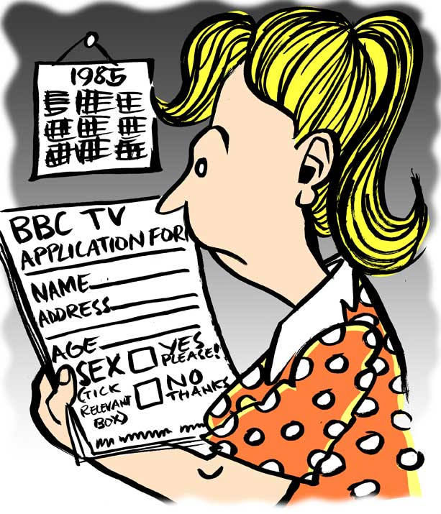

Ms SQL Server Data Types
Student:
Name
Birthday
Gender
Address
Marks…
Storage
What type of data each of field ???..............
Notes:
4

Slide 6
Ms SQL Server Data Types
SQL Server supports below data types. NULL is default value for most data type:
Exact Numerics
Approximate Numerics
Date and Time
Character Strings
Unicode Character Strings
Binary Strings
Other Data Types
Numberics
Date & Time
String
…
Data types
Notes:
4

Slide 7
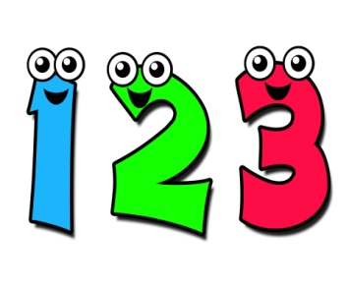
Exact Numbers
Interger-based data type
Data type | Size | Range of values
Bigint | 8 Bytes | -2^63 to 2^63-1
Int | 4 Bytes | -2^31 to 2^31-1
Smallint | 2 Bytes | -2^15 to 2^15 - 1
Tinyint | 1 Byte | 0 to 255
Bit | 1 Bit | 0 to 1
Notes:
5-17 bytes depending on precision

Slide 8

Exact Numbers
Exact decimal-based data type
Data type | Size | Range of values
Decimal(p,s) | 5 - 17 Bytes (depending on precision) | - Varies based on precision setting. - Maximum values are -10^38 +1 through 10^38 -1
(p is the maximum number of all digits (both sides of the decimal point), s is the maximum number of digits after the decimal point)
Numeric(p,s) | … | Identical to Decimal type
Smallmoney | 4 Bytes | - 214,748.3648 to 214,748.3647
Money | 8 Bytes | 922,337,203,685,477.5808 To 922,337,203,685,477.5807
Notes:
5-17 bytes depending on precision

Slide 9
Approximate Numerics
Data type | Size | Range of values
Float | 8 Bytes | - 1.79E+308 to 1.79E+308
Float(n) | Depends on the value of n
 | If 1 ≤ n ≤ 24: 4 Bytes (Precision: 7 digits) | 4 Bytes: - 3.40E + 38 to 3.40E + 38 8 Bytes: - 1.79E+308 to 1.79E+308
 | If 25 ≤ n ≤ 53: 8 Bytes (Precision: 15 digits)
Real | … | - 3.40E + 38 to 3.40E + 38
Note: SQL Server treats n as one of two possible values. If 1<=n<=24, n is treated as 24. If 25<=n<=53, n is treated as 53.

Slide 10
Date and Time
Data Type | Description | Example
Date | Stores dates between January 1, 0001, and December 31, 9999 | 2008-01-15
Datetime | Stores dates and times between January 1, 1753, and December 31, 9999, with an accuracy of 3.33 milliseconds | 2008-01-15 09:42:16.142
Datetime2 | Stores date and times between January 1, 0001, and December 31, 9999, with an accuracy of 100 nanoseconds | 2008-01-15 09:42:16.1420221
Datetimeoffset | Similar to the datetime2 data type, but also expects an offset designation of –14:00 to +14:00 | 2008-01-15 09:42:16.1420221 +05:00
Smalldatetime | Stores dates and times between January 1, 1900, and June 6, 2079, with an accuracy of 1 minute | 2008-01-15 09:42:00
Time | Stores times with an accuracy of 100 nanoseconds | 09:42:16.1420221

Slide 11
Character Strings
Non-Unicode string data types:
Data type | Description
Char(n) | - Fixed-length - Maximum length of 8,000 characters (1 ≤ n ≤ 8000)
Varchar(n) | Variable-length Maximum of 8,000 characters (1 ≤ n ≤ 8000)
Varchar(max) | Variable-length Maximum length of 2,147,483,647 characters
Text | Variable-length Maximum length of 2,147,483,647 characters Use varchar(max) instead

Slide 12
Unicode Character Strings
Unicode string data types are “double width”:
Data type | Description
Nchar(n) | - Fixed-length - Maximum specified length is 4,000 characters (1≤ n ≤ 4000)
Nvarchar(n) | Variable-length Maximum specified length is 4,000 characters (1≤ n ≤ 4000)
Nvarchar(max) | Variable-length Maximum length of 1,073,741,823 characters
Ntext | Variable-length Maximum length of 1,073,741,823 characters

Slide 13
Binary Strings
Data type | Description
Binary | - Fixed-length binary data - Maximum length of 8,000 bytes
Varbinary | Variable length binary data Maximum length of 8,000 bytes.
Image | Variable length binary data Maximum length of 2,147,483,647 bytes.

Slide 14
Other Data Types
Data Type | Description
Timestamp | Stores a database-wide unique number that gets updated every time a row gets updated
Hierarchyid | Special data type that maintains hierarchy positioning information
Uniqueidentifier | Stores a database-wide unique number that gets updated every time a row gets updated
Sql_variant | Stores values of various SQL Server-supported data types, except text, ntext, and timestamp
Xml | Stores XML data. You can store xml instances in a column or a variable (SQL Server 2005 only).
Table | Stores a result set for later processing

Slide 15
SQL OPERATORS
Section 2

Slide 16
What is an Operator in SQL?
An operator is a reserved word or a character used primarily in an SQL statement's WHERE clause to perform operation(s), such as comparisons and arithmetic operations.
Operators are used to specify conditions in an SQL statement and to serve as conjunctions for multiple conditions in a statement. Some types of most operators:
Arithmetic operators
Comparison operators
Logical operators.
1
2
3
Notes:
4

Slide 17
SQL Arithmetic Operators
Here is a list of the Arithmetic operators available in SQL
Operator | Description | Example
+ | Addition | a + b 🡪 30
- | Subtraction | a - b 🡪 -10
* | Multiplication | a * b 🡪 200
/ | Division | b / a 🡪 2
% | Modulus | b % a 🡪 0
( Assume variable a holds 10 and variable b holds 20)
Notes:
4

Slide 18
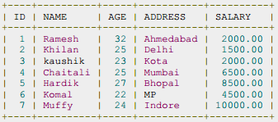

SQL Comparison Operators
Here is a list of all the Comparison operators available in SQL
Operator | Description | Operator | Description
= | equal to | >= | greater than or equal to
!=, <> | not equal to | <= | less than or equal to
< | less than | !< | not less than
> | greater than | !> | not greater than
Example
SQL: SELECT * FROM CUSTOMERS WHERE SALARY > 5000;
CUSTOMERS TABLE
Notes:
4

Slide 19
SQL Logical Operators
Operator | Description
ALL | Used to compare a value to all values in another value set.
AND | Used when both conditions are included
ANY | Used to compare a value to any applicable value in the list according to the condition
BETWEEN | Used to limit the values in a range e.g.
EXISTS | Used to search for the presence of a row in a specified table that meets certain criteria
IN | Included in the list e.g.
LIKE | Equal to some character (use quotes)
NOT | Opposite of the logical value
OR | Used when either of the condition is true
IS NULL | This checks if the field has a null
UNIQUE | Searches every row of a specified table for uniqueness
Notes:
4

Slide 20

Summary
Ms SQL Server Data Types
What is Ms SQL Server Data Type?
Some Ms SQL Server Data Types
SQL Operators
What is an Operator in SQL?
Some category of Operators
Demo
Ms SQL Server Data Types
Operators in SQL

Slide 21

Thank you

